Slide 1

Django REST Framework Part 1
Introduction to RESTful APIs, Setting up Django REST Framework, Creating API Endpoints
Program: EDGE-CSE CUET DIGITAL SKILLS TRAINING
Course: Python (Django) [Intermediate]
Lecture: Training Session-11 Date: 18th October, 2024 Duration: (2+2) hours
Instructor: Tanveer Rahman, Sr. Software Engineer, Friends Corp. Chuo-ku, Tokyo, JP shakil10vr@hotmail.com, 01626735005

Slide 2
Agenda
Introduction to RESTful APIs
Setting up Django REST Framework
Creating API Endpoints
Practical Tasks

Slide 3
Introduction to RESTful APIs
REST (Representational State Transfer):
Key Concepts:
Architectural style for designing networked applications.
Uses standard HTTP methods like GET, POST, PUT, DELETE.
Resources: Data entities (e.g., users, products).
Endpoints: URL paths to access resources.
TTP Methods: Define operations on resources (CRUD).

Slide 4
Why Use REST APIs?
Separation of client and server: Allows independent development.
Scalability: Each resource can be managed independently.
Flexibility: Supports different formats like JSON, XML.
Stateless Communication: Each request is independent.

Slide 5
Introduction to Django REST Framework (DRF)
Features:
Components:
Authentication and permissions.
Serialization for converting complex data types.
Serializers: Convert data between JSON and Django models.
Views: Handle requests and responses.
Routers: Automatically generate URL routes for views.
Django REST Framework is a powerful toolkit for building Web APIs in Django.
Browsable API for easier testing and debugging.

Slide 6
Setting Up Django REST Framework
Install DRF using pip:
pip install djangorestframework
Add 'rest_framework' to INSTALLED_APPS in settings.py:
INSTALLED_APPS = [
...
'rest_framework’,
]
Configure DRF settings (optional):
REST_FRAMEWORK = {
'DEFAULT_PERMISSION_CLASSES': [
'rest_framework.permissions.AllowAny',
],
'DEFAULT_RENDERER_CLASSES': [
'rest_framework.renderers.JSONRenderer',
'rest_framework.renderers.BrowsableAPIRenderer',
],
}

Slide 7
Task 1 - Setting Up DRF (30 mins)
Install Django REST Framework in your Django project.
Add 'rest_framework' to the INSTALLED_APPS in the settings.py file.
Run the development server and ensure there are no errors.

Slide 8
Creating Your First API Endpoint
Create a Django app (e.g., books) for API development:
python manage.py startapp books
Define a simple model (e.g., Book with fields for title and content).
Create a serializer for the model:
from rest_framework import serializers
from .models import Book
class BookSerializer(serializers.ModelSerializer):
class Meta:
model = Book
fields = ‘__all__'

Slide 9
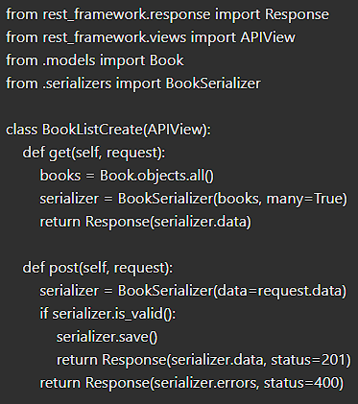
Writing Views for the API
Use DRF's built-in views (e.g., APIView or GenericAPIView).
Create a basic view for listing and creating posts:

Slide 10
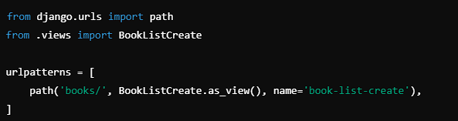
Configuring URL Routing for API Endpoints
Add URLs for the API in books/urls.py:
Include the app's URLs in the main urls.py

Slide 11
TASK 2- Creating API Endpoints (45 mins)
Create a new Django app and define a simple model (e.g., Author, Publisher).
Create a serializer and API view to handle GET and POST requests for the model.
Set up URL routing and test the endpoints using Django's browsable API.

Slide 12
Testing Your API
Use Django's Browsable API:
Navigate to /api/books/rest/ to test GET and POST requests.
Testing Tools:
Postman or cURL for making API requests.
Validation:
Check response status codes and JSON structure.

Slide 13
Task 3 - Testing and Extending the API (45 mins)
Use Postman to make GET and POST requests to your API.
Extend your API by adding support for retrieving, updating, and deleting individual posts.
Test all endpoints to ensure they work as expected.

Slide 14
Recap
RESTful APIs: Architectural style for building web services.
Django REST Framework: Toolkit for building Web APIs with Django.
Creating API Endpoints: Define models, serializers, views, and configure routing.

Slide 15
Additional Resources
DRF Documentation: https://www.django-rest-framework.org/
REST API Concepts: https://restfulapi.net/

Slide 16

Q&A Session

